Slide 1

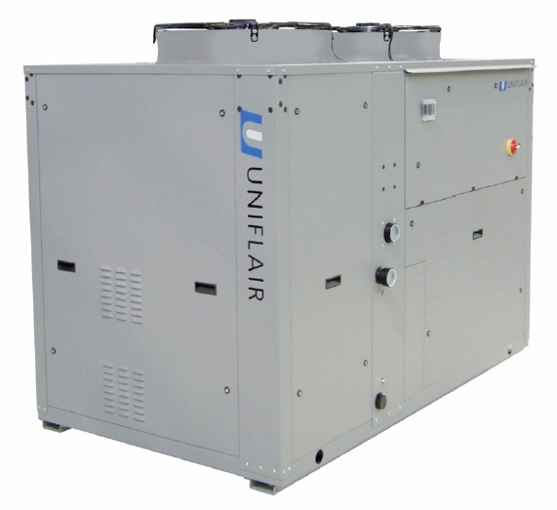
AQUAFLAIR
ERAC
ERAH
ERAF

Slide 2





UNIFLAIR CHILLERS
OVERVIEW
Product Range
1600
1400
1200
1000
800
Cooling Capacity [kW]
600
400
200
0
LRA
6-40 kW
ERA - ISA
50-110 kW
ARA
100-260 kW
BRW
300-1200 kW
BCW
300-1250 kW
BRE
400-1200 kW

Slide 3
OVERVIEW OF THE UNIT

Slide 4
ERA-C C/F/H
OVERVIEW OF THE UNIT
The new ERAC chillers, ERAH heat pumps and ERAF units with free-cooling system, feature state-of-the-art technology ensuring maximum reliability, safety, quiet operation and respect for the environment.
Refrigerant: R410A
Cooling Capacity: 50 – 110 kW
ERAC
Air-Cooled Water Chiller with Axial Fans
ERAH
Air / Water Heat Pump with Axial Fans
ERAF
Air-Cooled Water Chillers with Axial Fans and Free-Cooling System

Slide 5
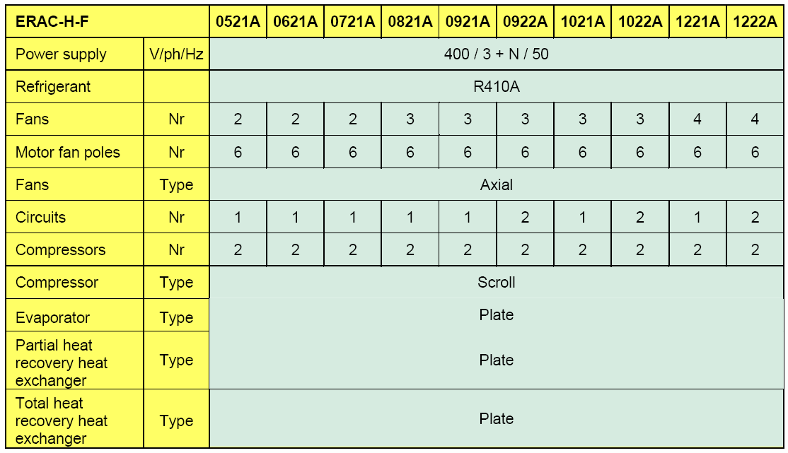
ERA-C C/F/H
OVERVIEW OF THE UNIT

Slide 6
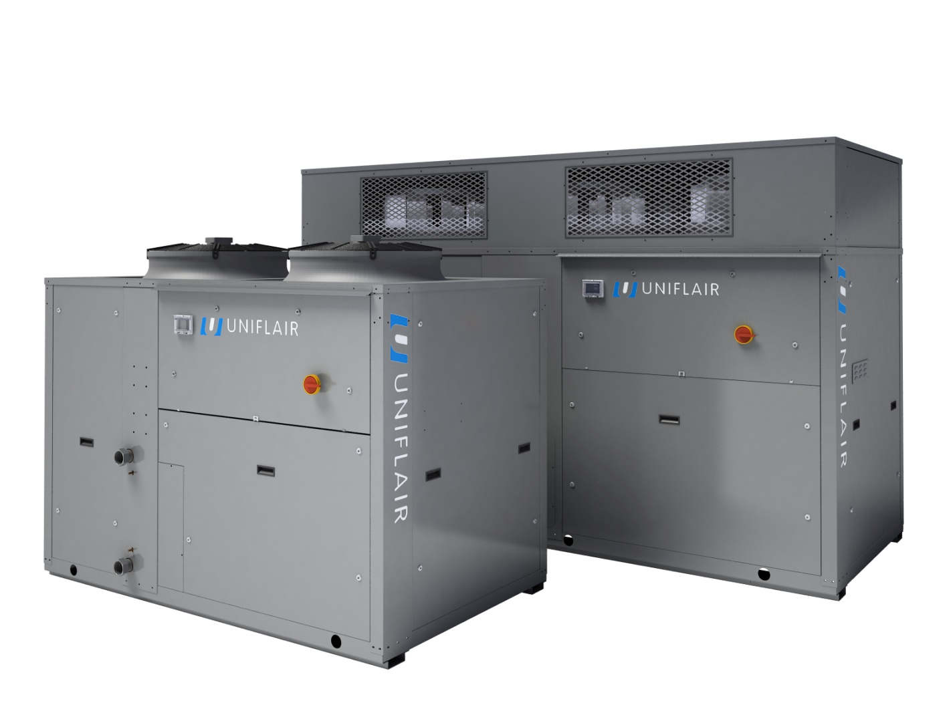
ERA-C C/F/H
OVERVIEW OF THE UNIT
120
110
100
90
kW
80
70
60
50
40
0521A
0621A
0721A
0821A
0921A
1021A
1221A
0922A
1022A
1222A

Slide 7

ERA-C C/F/H
OVERVIEW OF THE UNIT
Fans
Non ducted
Ducted

Slide 8
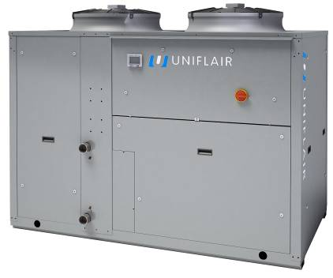
ERA C/F/H
OVERVIEW OF THE UNIT
Axial fans
Cooling only
ERAC
Heat pump
ERAH
Free-cooling
ERAF

Slide 9
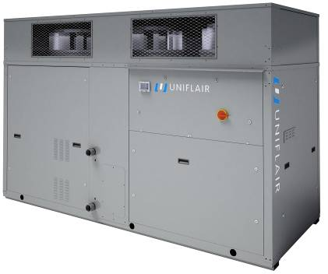
ERC C/F/H
OVERVIEW OF THE UNIT
Ducted fans
Cooling only
ERCC
Heat pump
ERCH
Free-cooling
ERCF

Slide 10
ERA-C C/F/H
OVERVIEW OF THE UNIT
The AQUAFLAIR^{ERAC/H/F} series is composed of ten chillers with nominal cooling capacities ranging from 50 to 110 kW.
The various versions can be managed by a UECH 400 control (microprocessor and local user terminal in a single element) or by a UpCO1m system composed of a basic interface board and a local user terminal.
The UECH control allows remote control but doesn’t permit connection to the Uniflair supervision system; the UpCO1m is suitable for configuration with a LAN card, I/O contact, clock card, RS485 serial adapter for connection to the Uniflair supervision system or a BMS (Building Management System).
Hermetic scroll compressors, environmentally friendly R410A refrigerant and an electronic thermostatic valve (in versions with UpCO1m control) allow increased energy efficiency in all operating conditions.

Slide 11
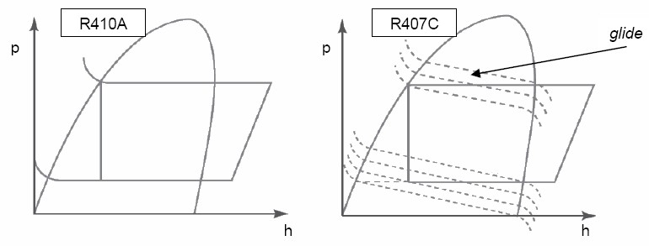

ERA-C C/F/H
MAIN COMPONENTS: R410A REFRIGERANT
R410A gas, whose behaviour is almost azeotropic (vapour and solution have the same concentration), is characterized by the absence of glide during state changing phases, which thus occur at a constant pressure without energy loss.
The greater thermal exchange capacity and a considerable reduction in the load loss, mean it is possible to install compact components with the same power output, thus benefiting from significant reductions in volume and a considerable increase in efficiency.

Slide 12
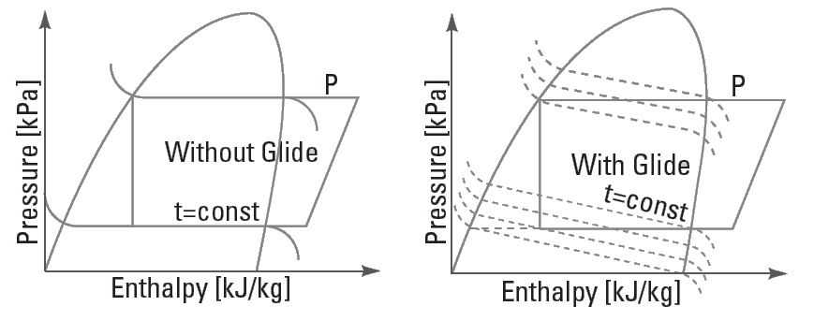

ERA-C C/F/H
MAIN COMPONENTS: R410A REFRIGERANT
Less pressure drops:
  – 20%* in the condenser
  – 40%* in the evaporator
Better exchange capacity (α_{internal})
  +35%*
  +50%**
Hardly any glide
* Compared to R22 / ** compared to R407C

Slide 13
ERA-C C/F/H
MAIN COMPONENTS: R410A REFRIGERANT
Easier to service
R410A
Simplicity and speed of maintenance
R410A
No need to remove all of the gas in the event of a leak
E.E.V.
Monitoring refrigerant leaks
R32
R125
Same vapour pressure
In the event of a leak the blend composition remains unchanged

Slide 14
ERA-C C/F/H
MAIN COMPONENTS: REFRIGERANT
R410a Refrigerant
Excellent performance:
High Intrinsic Efficiency (complete absence of glide → very low energy losses during the change of state phases)
Single-Component
Limited Direct Environmental Impact (G.W.P. = Greeenhouse Warming Potential) (O.D.P. = Ozone Depletion Potential)
Limited Indirect Environmental Impact (T.E.W.I. = Total Equivalent Warming Impact)
Refrigerant | R22 | R407C | R134a | R410A
O.D.P. | 0.055 | 0 | 0 | 0
G.W.P. | 1700 | 1520 | 1300 | 1720
NOTE:
• G.W.P. describes the relationship between the overall warming caused by a particular substance and the one caused by CO₂ carbon dioxide.
• O.D.P. is a parameter that expresses the contribution to the degradation of ozone

Slide 15
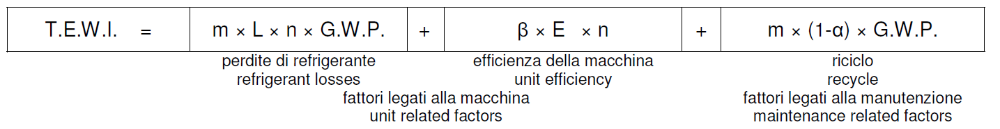
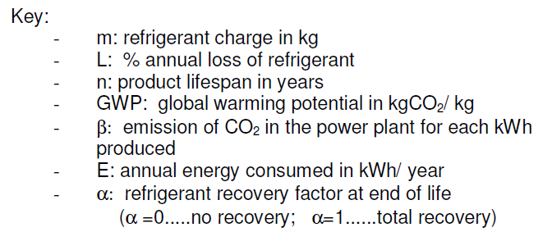
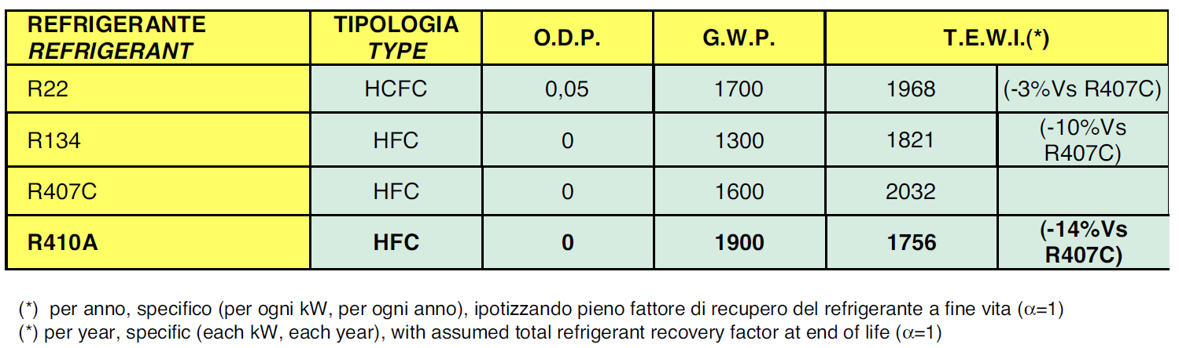
ERA-C C/F/H
MAIN COMPONENTS: REFRIGERANT
R410a Refrigerant
T.E.W.I.
Total Equivalent Warming Impact
refrigerant emission during the ‘lifecycle’ of the unit
indirect emissions resulting from the CO₂ emissions during energy production

Slide 16
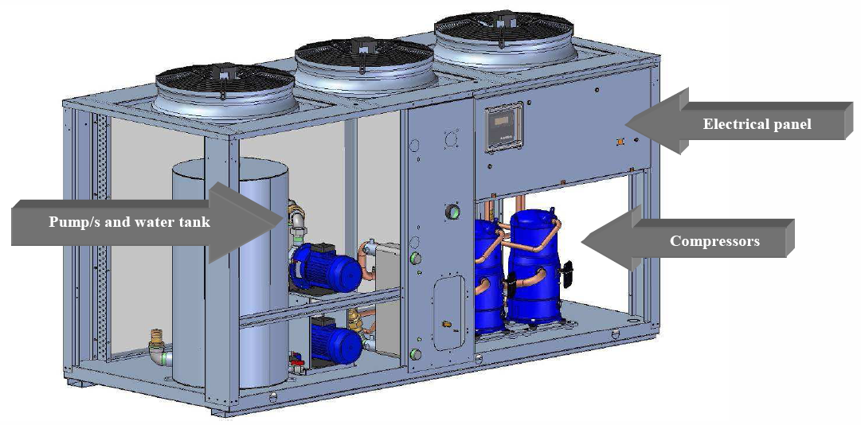
ERA-C C/F/H
MAIN FEATURES: EASY ACCESSIBILITY FOR MAIN COMPONENTS

Slide 17
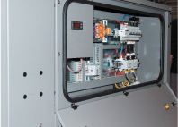
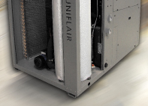
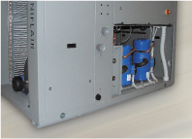
ERA-C C/F/H
MAIN FEATURES: EASY ACCESSIBILITY FOR MAIN COMPONENTS
Simplicity and speed of maintenance
Electrical sect.
Panels equipped with quarter-turn fasteners and handles
Upper panel is not riveted
Dedicated access for:
Compressors and refigerant circuits
Water tank
Pump group
Pumps
Hydraulic sect.
Refrigerant sect.

Slide 18
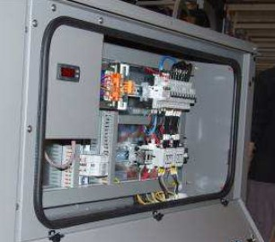
ERA-C C/F/H
MAIN COMPONENTS: ELECTRICAL PANEL
ELECTRICAL PANEL
The panel conforms to EC directives and features:
IP54 protection grade;
12 / 24 V and 230 V auxiliary transformer;
General door interlock switch;
Thermo-magnetic protection for the compressors, fans and auxiliaries;
Remote control switches for the compressors;
Anti condensation heaters;
Motor protection for the pump/s and the free cooling pump (ERAF).

Slide 19
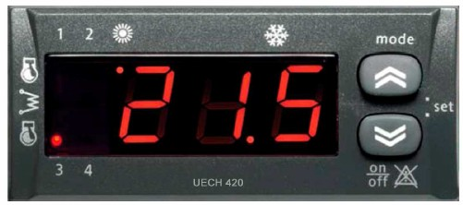
ERA-C C/F/H
MAIN COMPONENTS: MICROPROCESSOR CONTROL – UECH CONTROL
MICROPROCESSOR CONTROL
For the ERAC/H/F chillers and heat pumps the following types of control are available:
UECH
UpCO1m
UECH CONTROL
The UECH microprocessor control is integrated with the local user terminal where the regulation software is housed. This control includes the following components:
User terminal with LCD display and signal lights;
Outlet chilled water temperature regulation;
Anti-freeze protection;
Free-cooling management (ERAF);
Protection and timing of compressors and pumps;
Modulating condensing pressure control;
Total / partial heat recovery management;
High pressure transducers;
Alarm code signalling and centralisation for general alarm reports as a clean contact;
Remote cycle inversion control (ERAH)
ON-OFF remote control.

Slide 20
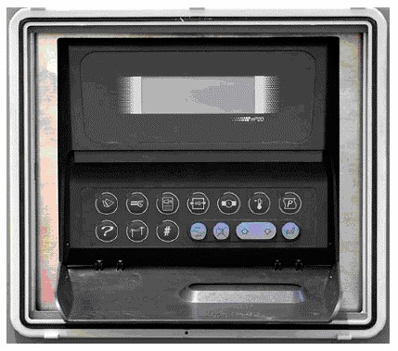
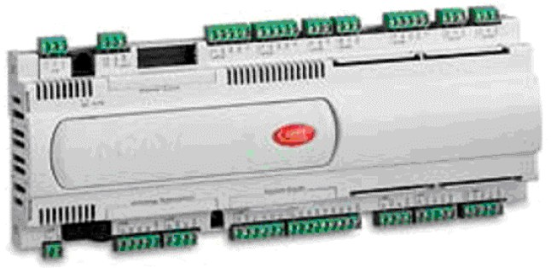
ERA-C C/F/H
MAIN COMPONENTS: MICROPROCESSOR CONTROL – UpCO1m CONTROL
UpCO1m CONTROL
The UpCO1m control system consists of two sections:
a control board which consists of one I/O board containing the regulation software and which is fitted on the electrical panel of the unit;
a User Terminal which consists of a user interface and which can be installed locally or remotely.
Features:
16 bit microprocessor, 14 MHz, internal registers and operations at 16 bit, 512 byte of internal RAM;
Flash Memory up to 2 Mb per programme;
128 kb static RAM;
RS485 serial output for LAN;
24 Vac/Vdc power supply;
Telephonic connection for the user terminal;
LED indication of power supply.

Slide 21
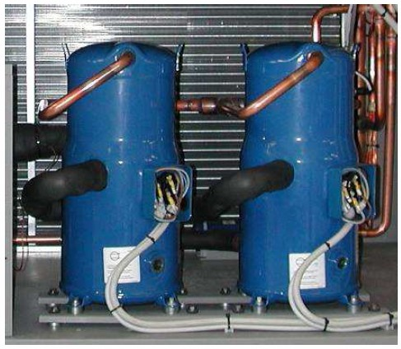

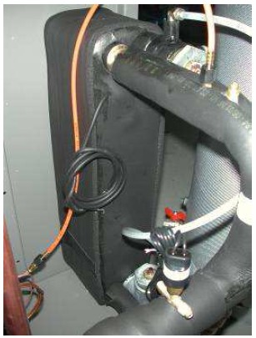
ERA-C C/F/H
MAIN COMPONENTS: COMPRESSOR & WATER SIDE EXCHANGER
COMPRESSORS
All the units are equipped with two highly efficient hermetic Scroll compressors with a low sound power level and integrated thermal protection.
ERAC/F units with the suffix **21 are provided with two compressors connected in parallel on the same refrigerant circuit: the unit therefore features two partialisation steps, ensuring modulation of the cooling capacity.
WATER SIDE EXCHANGER
The direct expansion brazed plate evaporator / condenser is entirely made of stainless steel and features counter flow.
The exchange surface is configured in such a way as to maximize the exchange coefficient with reduced pressure drops.
The inlet and outlet connections are equipped with air bleeding and draining. The closed-cell expanded neoprene insulation prevents the formation of condensation and reduces heat dispersion.

Slide 22
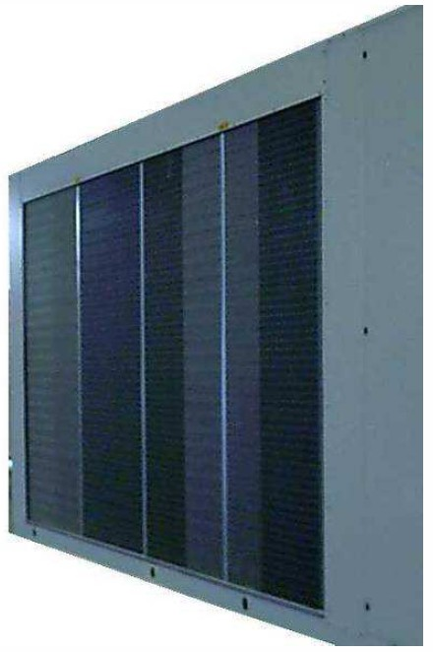
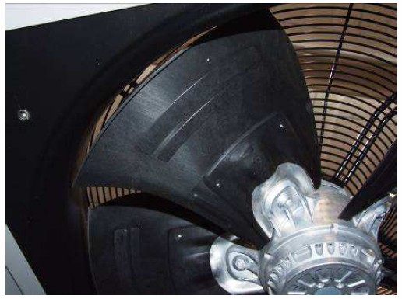
ERA-C C/F/H
MAIN COMPONENTS: AIR SIDE EXCHANGER & FANS
AIR SIDE EXCHANGER
The condenser (evaporator) is sized in order to operate at high ambient temperatures, it is composed of a finned pack exchange coil with aluminium fins and mechanically expanded copper piping to obtain improved metallic contact for maximum exchange capacity.
FANS
ERAC/H/F units are equipped with new generation axial fans made from a composite material: aluminium and reinforced plastic.
This solution creates significant advantages in terms of efficiency, reliability and noise level.

Slide 23
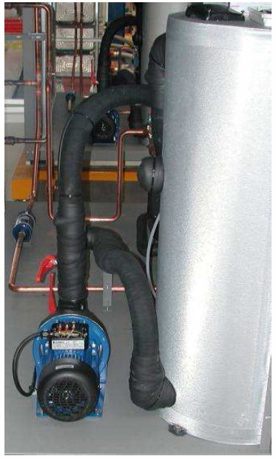
ERA-C C/F/H
MAIN COMPONENTS: HYDRAULIC CIRCUIT
HYDRAULIC CIRCUIT
ERAC/H/F units are available with the following hydraulic configurations:
Without pump;
Unit equipped with 1 pump;
Unit equipped with 2 pumps;
Unit equipped with 1 pump and a water tank;
Unit equipped with 2 pumps and a water tank;
Unit equipped with 1 pump and a water tank in primary/secondary configuration;
Unit equipped with a water tank only.
Main hydraulic components:
Dryer filter;
Liquid sight glass;
Dual flow thermostatic expansion valve with external equalisation in stainless steel;
High and low pressure switches;
Cycle inversion valve (ERAH);
Liquid receiver (ERAH);
Differential water flow pressure switch.
Direct onboard connections for:
- Checking the liquid sight glass;
- Setting the expansion valve;
- Refrigerant load.

Slide 24
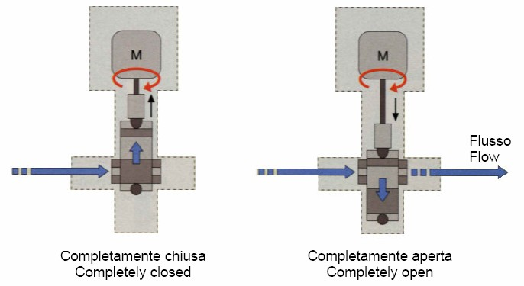
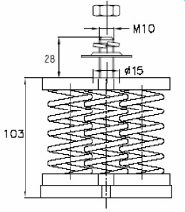
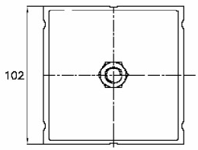
ERA-C C/F/H
MAIN COMPONENTS: ELECTRONIC EXPANSION VALVE & ANTIVIBRATION SUPPORTS
ELECTRONIC EXPANSION VALVE
Units equipped with UpCO1m control use an electronic expansion valve driven by a driver which sends signals to open and close the valve depending on the level of super-heating required.
When the compressor is idle, refrigerant doesn’t flow through the valve. When there is a request for cooling, and the compressor is activated, the driver is informed of the action which is taking place and it starts to control the mass flow of refrigerant, positioning the electronic expansion valve in the operating conditions required according to the operation of the system.
ANTIVIBRATION SUPPORTS
Both rubber and spring anti-vibration supports are available as optional to insulate the unit from the support slub.

Slide 25
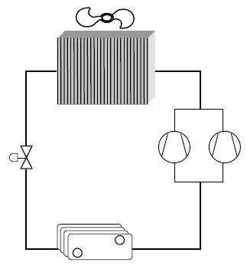
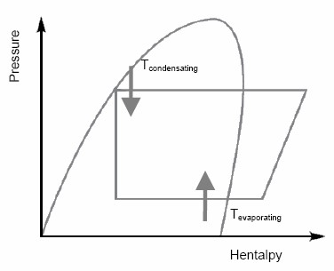
ERA-C C/F/H
MAIN FEATURES: TANDEM CIRCUIT
Tandem units are equipped with two separated compressors on the same circuit.
The exchange surfaces are constant and sized for the maximum available power which can be supplied; this means that, when the power is reduced (partialized unit), the thermal difference in the heat exchangers are reduced (due to an increase in the evaporation temperature and a decrease in the condensing temperature of the refrigerant cycle) allowing elevated efficiency even during operation at partial load.

Slide 26
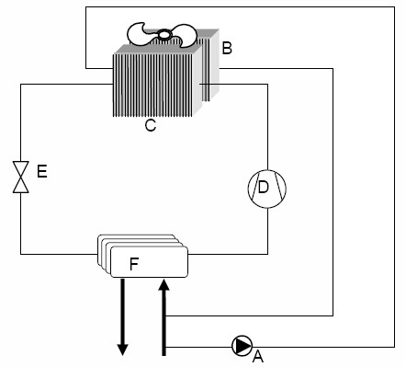

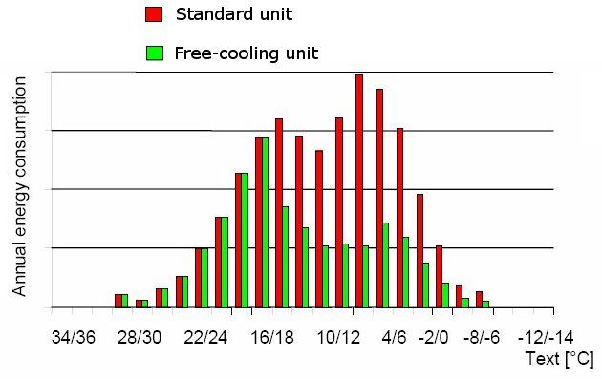
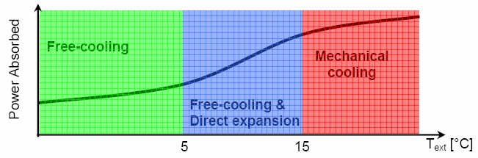
ERA-C C/F/H
MAIN FEATURES: FREE-COOLING SYSTEM
ERAF are free-cooling chillers which exploit the external low temperature to reduce, or even eliminate (depending on the external temperature itself), the use of the refrigeration cycle, i.e. the compressors, which are the components principally responsible for energy consumption.
This system exploits the air / water exchangers which are integrated in the unit itself. In this way, chilled water is produced using external air; energy consumption is therefore limited to the fans.

Slide 27
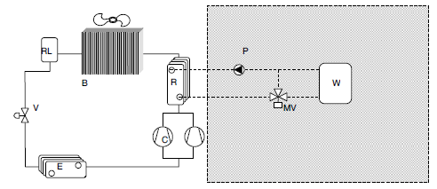
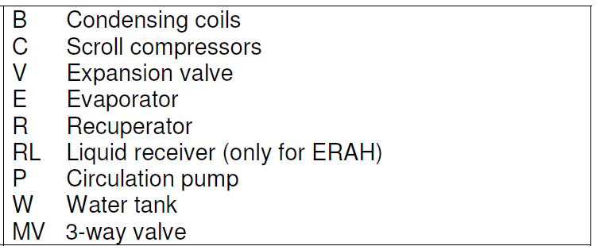
ERA-C C/F/H
MAIN FEATURES: PARTIAL HEAT RECOVERY
Partial Heat Recovery
In the AQUAFLAIR ERA range, both partial and total heat recovery are carried out by plate heat exchangers placed between the discharge section of the compressor and the air condenser; the following diagram shows the recovery circuit within the unit and the circuit used.
For correct operation of the chiller it is necessary to avoid supplying the recovery exchanger (R) with water which is too cold (temperatures lower than 30°C).
For this reason, it is advisable to install a 3-way valve
(MV ) as shown in the diagram.

Slide 28
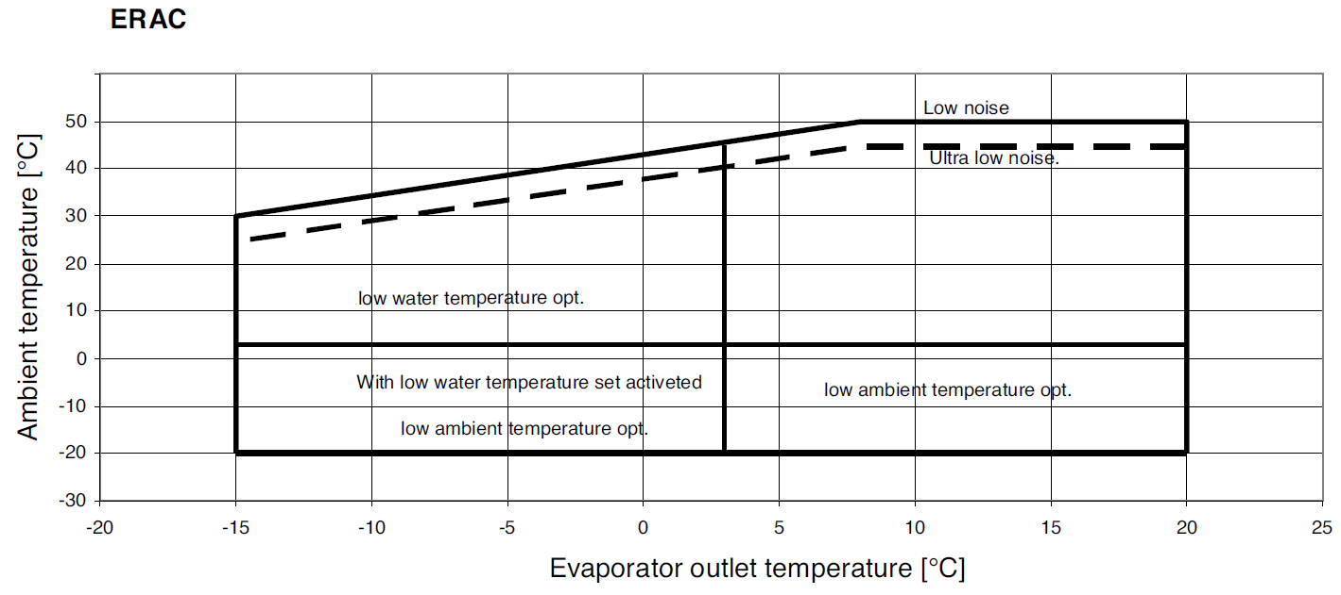
ERA-C C/F/H
MAIN FEATURES: OPERATING LIMITS
Operating Limits
All the versions are equipped with modulating condensation control as standard, but in order to
operate with external temperatures lower than 0°C, it is necessary to fit the units with crankcase
heaters for the compressors and an anticondensation heater for the electrical board.
These devices are in the “Low ambient temperature” option.
When the unit is selected with “Low ambient temperature” option, the unit is fitted with antifreeze heaters on evaporator, evaporator and pump/s, evaporator and water tank, evaporator, pump/s and water tank according to the unit’s configuration.

Slide 29
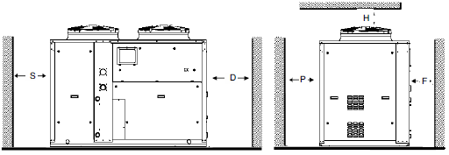
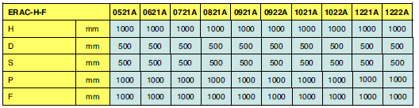
ERA-C C/F/H
MAIN FEATURES: WORKING SPACE
Working Space
The diagram below shows the minimum recommended distance to be left clear for correct unit operation and to allow access to the unit for maintenance.
WARNING: prevent air recirculation between the air discharged and the air taken in by the condenser.
NOTE: If three of the dimensions H, P, D, S are at their minimal limit, it is advised that the other dimensions are least three times that of the minimal limit listed on the above table.

Slide 30
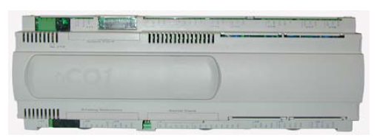
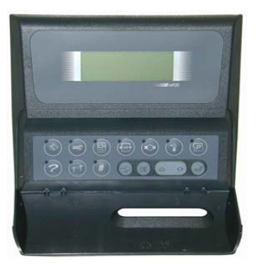
ERA-C C/F/H
REGULATION PROGRAM
REGULATION PROGRAM
UpCO1m + mP20II

Slide 31
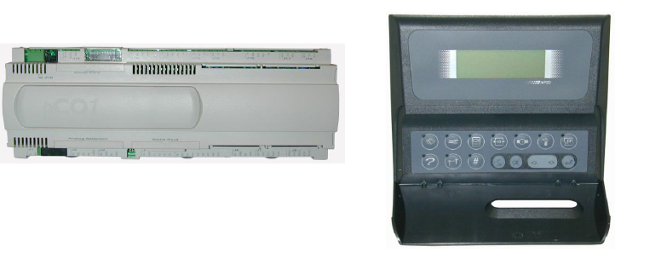
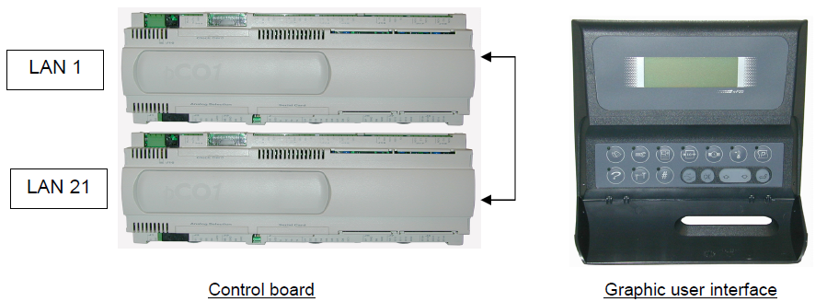
ERA-C C/F/H
REGULATION PROGRAM: GENERAL FEATURES
The microprocessor control manages unit operation.
The control is essentially formed of:
a microprocessor control board, housed inside the electrical panel;
a graphic user interface.
All control algorithms are resident in the microprocessor control card, and all operating parameters, which can be viewed and set via the user terminal, are stored there.

Slide 32

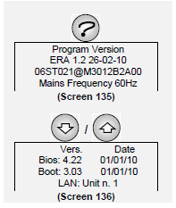


ERA-C C/F/H
REGULATION PROGRAM: PROGRAM VERSION
By pressing the key, you can see the version of the control program burnt in the Flash EPROM.
This information is essential when you want to add a new unit to a group of units connected in a Local Area Network because all the units connected with each other in a LAN must have the same software version.
Also, when contacting a service centre, it is important to quote the version of the control program contained in the Flash EPROM accurately.

Slide 33


ERA-C C/F/H
REGULATION PROGRAM: ACCESS TO DATA IN CONSULTING OR PROGRAMMING MODE
Control parameter consulting and programming modes can be entered directly using the keys on the user terminal:
ACCESS IN READ-ONLY MODE: allows you to consult data, but you are not allowed to edit them;
2. ACCESS IN PROGRAMMING (READING AND WRITING) MODE allows you to alter stored data and entails:
2.a. pressing the key for a second (until you hear audible feedback);
2.b. immediately pressing one of the following keys:
2.c. entering the PASSWORD contained in the sealed envelope supplied with this manual intended for the head of maintenance .
The yellow LED associated with each key has the following function:
- LED lit: access to forms in read-only mode;
- LED flashing: access to forms in programming mode (when one of the membrane keys has been pressed in sequence with the "P" key)

Slide 34
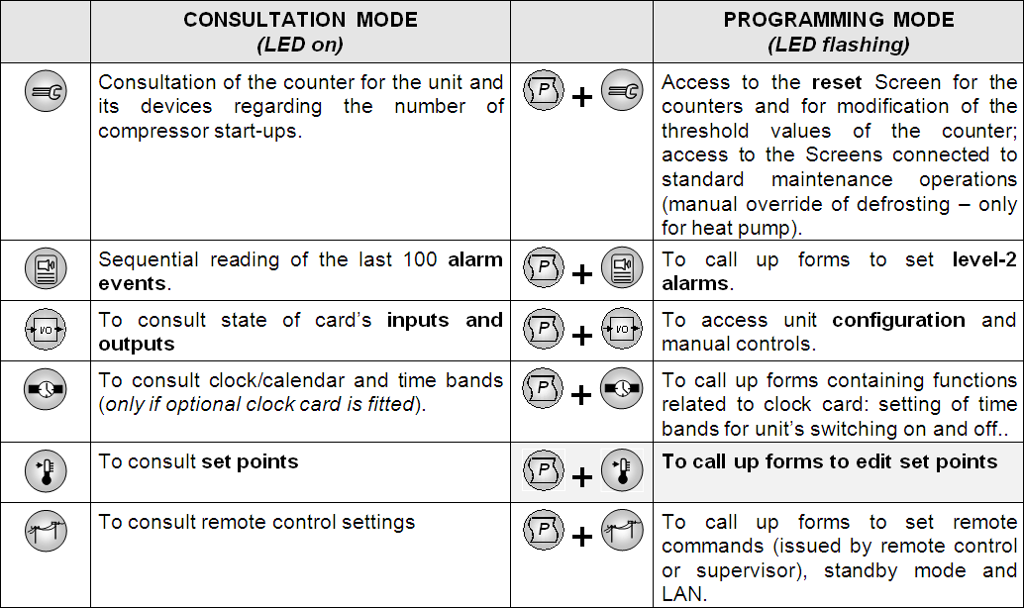
ERA-C C/F/H
REGULATION PROGRAM: ACCESS TO DATA IN CONSULTING OR PROGRAMMING MODE

Slide 35
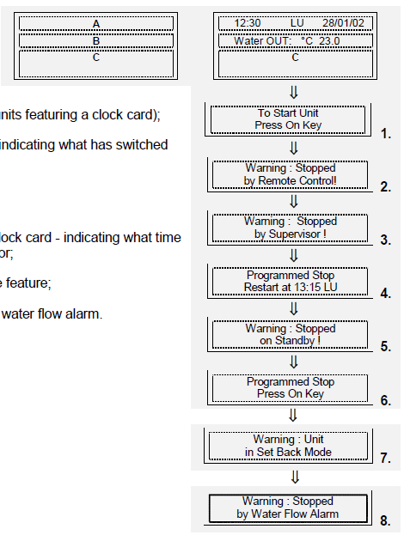
ERA-C C/F/H
REGULATION PROGRAM: DISPLAY INFORMATION WITH UNIT OFF
When the unit is powered but not running,
3 fields are active on the user terminal display:
A. Time and date (only in units featuring a clock card);
B. Outlet water temperature;
C. One of the following messages indicating what has switched the unit off:
1. ON/OFF button;
2. Remote control;
3. Supervision system;
4. Timed switch-off - in units with clock card - indicating what time the next restart is programmed for;
5. Automatic unit inversion cycle;
6. Manual switch-off (on by remote control);
7. Setback mode;
8. Forced switch-off subsequent to water flow alarm.

Slide 36
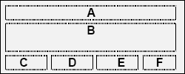
ERA-C C/F/H
REGULATION PROGRAM: INFORMATION DISPLAYED WITH THE UNIT RUNNING
When the unit is running, the STATUS SCREEN appears on the display
featuring 6 active fields:
Current time (only in units featuring a clock card), outlet water
temperature.
B. Functions in progress; the following messages are given depending on the working conditions:
COOLING"/"HEATING“ / "RECOVERY HEAT";
"PUMP-DOWN CIRC. 1”/ "PUMP-DOWN CIRC. 2”;
"PUMP-DOWN CIRC. 1-2” / ”DEFROST CIRC.1”;
DEFROST CIRC.2” / ”DEFROST CIRC.1-2”.
C. Where applicable, it indicates automatic cycle operation override:
"MAN" in operating mode with manual control;
"FORCE" when switching on using manual forcing;
"WATCH" when the unit enters “setback mode” to keep temperature parameters within the set limits.

Slide 37



ERA-C C/F/H
REGULATION PROGRAM: INFORMATION DISPLAYED WITH THE UNIT RUNNING
D. indicates unit’s slave status, which can be one of the following:
"ON": if the unit was switched on by the user teminal
"REMOTE": to a remote contact;
"SUPERV.": to a Supervisor;
"CYCLE": to automatic cycle inverting standard units and standby units;
"TIME": to a programme for operation based on time bands.
E. indicates trouble status, which can be one of the following:
"ALARM" : when there is an alarm;
"SERV": when a meter totalling hours of operation exceeds the threshold.
F. identifies with "LAN01", "LAN02", … when a number of units are connected in LAN.
In this case, if a shared user terminal is used, it is possible to scroll among the units on the same LAN by pressing + keys at the same time.

Slide 38


ERA-C C/F/H
REGULATION PROGRAM: HOUR-METER READING AND PROGRAMMING
This part of the program is used to determine service intervals for the unit’s components: when the device in question exceeds the operating hours threshold indicated, the microprocessor reports the service request by activating the alarm condition and sending the “SERV” message up on the main form.
There are also two forms featuring the number of times the compressor starts (with the option of resetting the count).
The forms give the number of hours accumulated and operating thresholds. To edit limits and/or reset the hour-meter, you must call up the subroutine in programming mode.
The functions regard the following unit components:
1. Compressors;
2. Water circulation pumps;
3. Compressors starting number;
4. Command manual Defrost circuit;

Slide 39
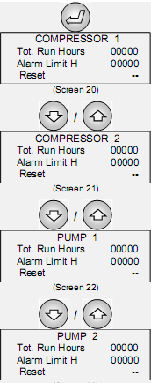
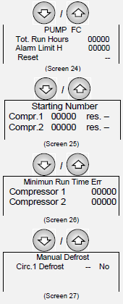
ERA-C C/F/H
REGULATION PROGRAM: HOUR-METER READING AND PROGRAMMING
For each device, it is possible to:
• read the accumulated number of hours of duty;
• set operating thresholds - setting the threshold to 0 inhibits the SERVICE request warning;
• reset the hour-meter (RESET = "OK"), e.g. once the component has been serviced and/or replaced.
Parameters can only be edited within the permissible setting ranges.
Screens on the left feature the progressive number of starts of the unit’s compressors and pumps, with the option of resetting the count.

Slide 40


ERA-C C/F/H
REGULATION PROGRAM: CONSULTING INPUT AND OUTPUT STATES
This part of the software, which can be called up directly by pressing the I/O key, allows to check the state of the board’s inputs and outputs.
The codes given on the display are the same ones used to identify components in the unit and in the relevant literature (electrical and refrigerant drawings).
DIGITAL INPUTS (ID1 - ID14):
Remote On-Off = On-Off remote contact
HP1-TP1 = high pressure switch for circuit 1 and thermo protector for compressor 1
HP2-TP2 = high pressure switch for circuit 1 and thermo protector for compressor 2
Heat Recover = start up contact of heat recovery
AL Inverter = alarm contact inverter compressor
THPES = thermo protectors for the water circulation pump Free-Cooling
FS = flow meter
THPE1-2 = thermo protectors for the water circulation pump
Change SETP. = commutation contact for the working setpoint
Ter. Fan = thermo protectors fan
RSF = phase sequence relay
I.V.LimitSw. = limit switch free-cooling valve
Rem. SUM/WIN = commutation contact for SUMMER/WINTER operation

Slide 41



ERA-C C/F/H
REGULATION PROGRAM: CONSULTING INPUT AND OUTPUT STATES
ANALOGUE INPUTS (B1 - B8):
Supplies the readings of the TEMPERATURE and PRESSURE sensors connected to the board.
ANALOGUE OUTPUTS DIGITAL OUTPUTS (C1 - C13):
CC1,CC2 = compressor contacts;
CPE1,CPE2 = pump contacts;
ETV Cond. = solenoid valves condensing circuit;
RAT-RAC = anti-freeze heaters;
“A” Alarm = digital output for “A” type alarm signals;
ETF1,ETF2 = solenoid valves on 2 circuits;
CPFC = free-cooling pump control;
VO1- VO2 = solenoid valve, compressor oil
VIC = cycle inversion valve
FC STDBY = Free-cooling valve contact;
Isol Valve = isolating valve contact;
“B” Alarm = digital output for “B” type alarm signals.
ANALOGUE OUTPUTS (Y1-Y4)
Y1 Ventil rad.= Radial fan speed
Y2 Comp. Inv = control signal of the inverter compressor
Y3 Ventil ass. = axial fan speed axial

Slide 42

ERA-C C/F/H
REGULATION PROGRAM: CONFIGURING THE UNIT DEVICES: "Hardware Config."
Unit’s configuration mode is accessible by keeping pressed the P programming key until you hear a short audible signal and then pressing the I/O key.
Once you have entered the password (by factory: 121), the relevant form is called up, comprising three options: move the cursor vertically to the line you are interested in using the DOWN key and then call up the forms by pressing the ENTER key.
HARDWARE CONFIGURATION:
The unit control program needs to be “configured”, i.e. adapted to the unit it is installed in. During this stage, you must define all elements making up the unit that the microprocessor will be required to control. This operation is generally only required when the controller is installed actually on the unit, in which case, therefore, it is performed at the factory during final testing. Nonetheless,. configuration may be required as a result of later changes made to the unit
Consequently, forms concerning configuration appear in English and are intended for use by service engineers only.

Slide 43


ERA-C C/F/H
REGULATION PROGRAM: CONFIGURING THE UNIT DEVICES: "Hardware Config."
DEVICES CONNECTED TO THE UNIT:
Allows you to:
• set unit type depending on whether the unit in question is a:
- standard-version chiller
- chiller for low temperatures
- chiller with condensation heat recovery
- heat pump
- heat pump with condensation heat recovery
- chiller with free cooling
• activate the heat recovery mode if included.
Only some of the following forms will be displayed, depending on the type of unit.
CONFIGURATION OF FAN SPEED REGULATOR:
Allows to set the type of speed regulator used according to the fans installed.

Slide 44





ERA-C C/F/H
REGULATION PROGRAM: CONFIGURING THE UNIT DEVICES: "Hardware Config."
CONFIGURATION OF COMPRESSOR SPEED REGULATOR:
Allows the activation of the speed regulation of the compressor via inverter.
PID SETTINGS:
Allows the proportional band and integral time regulation to be set.
CONFIGURATION OF PUMPS:
Allows the number of water circulation pumps installed on the unit to be set.
CONFIGURATION OF THE REFRIGERANT AND EXV:
Allows to set the type of refrigerant gas used and the activation of the electronic expansion valve present with associated model details.
COOLING SETPOINT LIMITS:
Allows the minimum and maximum set-point limits to be set.

Slide 45



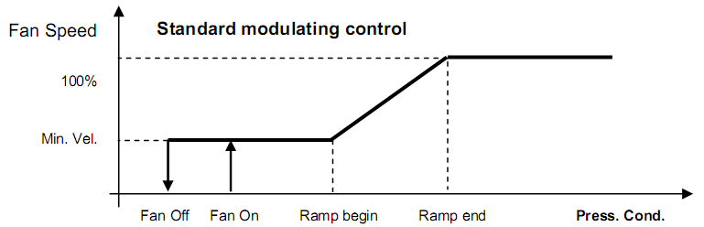
ERA-C C/F/H
REGULATION PROGRAM: CONFIGURING THE UNIT DEVICES: "Hardware Config."
PUMP-DOWN CONFIGURATION:
Allows pump-down mode to be activated and the maximum time for the procedure to be set.
FREQUENCY OF THE ELECTRIC NETWORK:
This Screen allows the frequency of the electric network.
FAN REGULATION - STANDARD MODE:
This Screen allows the fan modulation parameters to be set on the basis of the condensing pressure: by disabling the low-noise mode, the fan speed regulation on a 2 steps regulation, as illustrated in the diagram below.

Slide 46

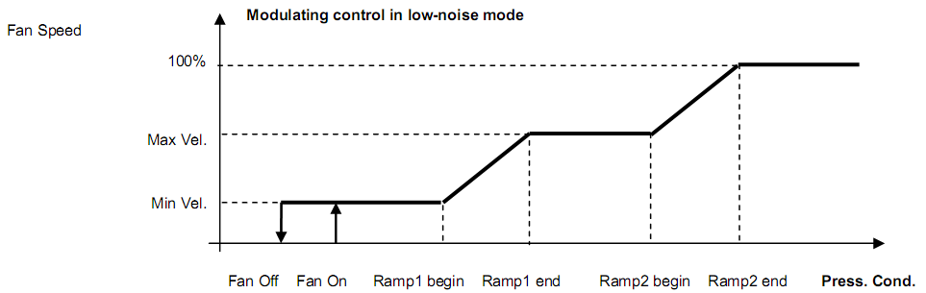

ERA-C C/F/H
REGULATION PROGRAM: CONFIGURING THE UNIT DEVICES: "Hardware Config."
FAN REGULATION - LOW NOISE MODE:
By enabling the low-noise mode, the fan speed regulation is based on a ramp of 3 steps. The Screen on the left allows the parameters related to the 2nd modulation step.
FAN REGULATION IN FREE-COOLING MODE:
This Screen allows the fan speed parameters to be set during the free-cooling mode with partial or total signal.

Slide 47
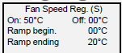



ERA-C C/F/H
REGULATION PROGRAM: CONFIGURING THE UNIT DEVICES: "Hardware Config."
FAN REGULATION IN CHILLER/HEAT PUMP MODE
These masks allow the parameters for fan modulation to be set depending on the condensation pressure when in Chiller/Heat Pump mode.
SET-POINT FREE-COOLING ACTIVATION:
In free-cooling units, this Screen appears to enable the activation ΔT to be set. When the external air temperature is lower than the inlet water temperature, the unit enters in free-cooling mode: the water circulation pump activates by means of the free-cooling coil and the compressor steps change in order to increase the efficiency of the air-water exchanger.
TOTAL FREE-COOLING SETPOINT ACTIVATION:
This Screen allows to set the ΔT between the inlet and outlet water temperature to enable total free-cooling.
ACTIVATION OF INTELLIGENT FREE-COOLING:
This Screen allows the management of intelligent free-cooling with the unit in stand-by, when there are more units connected in LAN.

Slide 48
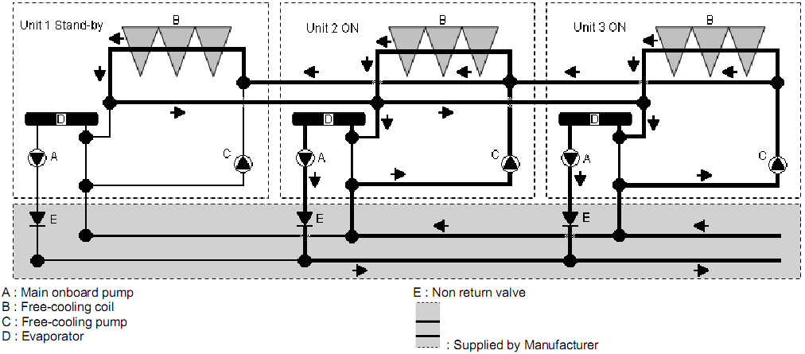
ERA-C C/F/H
REGULATION PROGRAM: CONFIGURING THE UNIT DEVICES: "Hardware Config."
In the diagram shown below, an example is shown where unit 1 is in stand-by and units 2 and 3 are running and connected with intelligent free-cooling. If the external temperature is able to activate the free-cooling, the control system of the units running, controls the start-up of the fans of the unit in stand-by (1) and the start-up of the free-cooling pump (C) of the units which are running (2 and 3). In this way the water is sent to all of the available free-cooling coils.

Slide 49




ERA-C C/F/H
REGULATION PROGRAM: CONFIGURING THE UNIT DEVICES: "Hardware Config."
ANTI-FREEZE:
This Screen gives the possibility to activate or not the circulation pump through the free-cooling coils in anti-freeze operation. If this function is activated in the stand-by unit, the FC pump is switched on as soon as the external temperature falls below 4,5°C; it turns off when it rises above 5.5°C.
N.B.: Only a correct mix of glycol ensures that the coils do not freeze if the external temperature falls below zero: the function indicated cannot guarantee the integrity of the coil, above all in freezing temperatures.
ANTI-FREEZE:
This mask sets the percentage of glycol in the circuit water and set the setpoint to activate the antifreeze.
WATER ISOLATING VALVE CONTROL:
These Screens allow the activation of the water isolating valve control by setting:
• activation;
• movement control (switch for end of run or run time)
• delay alarm activation (water flow absence)

Slide 50





ERA-C C/F/H
REGULATION PROGRAM: CONFIGURING THE UNIT DEVICES: "Hardware Config."
HIGH PRESSURE TRANSDUCER - RANGE REGULATION:
This Screen allows the reading range of the high pressure transducer to be set.
LOW PRESSURE TRANSDUCER - RANGE REGULATION:
This Screen allows the reading range of the low pressure transducer to be set.
SENSOR ADJUSTMENT:
This Screen and the following ones allow the temperature sensors which can be found in the unit to be adjusted (“read value”), when there is a difference between the value measured by the probe and the actual temperature, measured by a precision instrument.
REMOTE SETPOINT :
This Screen allows to set the remote set-point function through the pCOE expansion board or the RS485 serial card.

Slide 51




ERA-C C/F/H
REGULATION PROGRAM: CONFIGURING THE UNIT DEVICES: "Hardware Config."
REMOTE SETPOINT:
Allows the relative control parameters of the remote modulating control of the unit operating values to be set.
REMOTE SETPOINT :
Allows to set the remote set-point through the supervision variable Integer 49.
HEAT RECOVERY:
Allows setting of the ΔT between the condensation temperature and the water temperature for heat recovery.
EMERGENCY HEAT RECOVERY:
Allows activation of the Quick Start of the compressors after a power supply interruption of at least 3 minutes and if the chilled water outlet temperature is above of both the set-point and the settable value.

Slide 52


ERA-C C/F/H
REGULATION PROGRAM: CONFIGURING THE UNIT DEVICES: "Hardware Config."
BUZZER ACTIVATION TIME:
Allows the maximum activation time of the buzzer activation when an alarm is active to be set.
SETTING THE ACCESS PASSWORD:
Allows the access password to be set:
Default SETTINGS PASSWORD: 000000
Default SERVICE PASSWORD: 00121

Slide 53


ERA-C C/F/H
REGULATION PROGRAM: CONFIGURING THE UNIT DEVICES: "Hardware Config."
PROGRAM SETUP:
This operation is performed automatically if the software is replaced. It may prove useful if you find data (set-points, configurations, etc.) are “contaminated” as it allows to clear the memory (including data concerning the unit’s HARDWARE configuration): all set-points are automatically restored to their respective factory values.
Following this operation, the controller must be reconfigured and you will need to adjust all the set-points you want to be different from the default ones.
AL. PAGE CLEAR-UP:
By clearing the alarm log, you erase the all alarm events stored in the memory.
HARDWARE SET-UP:
Used to run an automatic procedure for detecting devices connected to the controller. This operation is useful when you want to add an option to the card, replace a sensor, or when the display features the "NC“ message instead of the temperature sensor’s reading.

Slide 54



ERA-C C/F/H
REGULATION PROGRAM: DELAY SETTINGS
The Screen on the left concerns initial transient behavior and gives you the option to set:
• POWER ON DELAY: length of delay before the unit restarts after a power cut; it is required to prevent simultaneous starts in multiple installations. In LAN-connected units, a progressive start sequence (unit 1, unit 2,…) is run automatically, with 5-second intervals between one unit and the next.
• START TRANS: length of time between the unit switching on and the control starting; this is the initial period deemed necessary to give the control system time to stabilize.
During this period, the FS water flow-switch reading is also disabled. This allows the unit to start without generating the "No waterflow" alarm, especially in units with a motorized valve.
• TEMP. AL. DELAY: delay - from when the unit starts - before environmental condition alarms are reported (temperatures).

Slide 55



ERA-C C/F/H
REGULATION PROGRAM: DELAY SETTINGS
This Screen allows the anti-hunting time constant to be set to avoid excessive differences in temperature. The greater the heat inertia of the water circuit, the greater this value must be set.
This Screen allows the water flow-switch (FS) parameters to be set: the first parameter is the acquisition delay for the signal issued by the flow-switch when the unit is started, while the second parameter is the length of the delay before the alarm, if there is one, is reported after the pump starts. Lastly, the third parameter (only displayed if there are two pumps) is the rotation time for the pumps operation.
This Screen allows the compressor timing to be set:
minimum time between two starts for a single compressor;
minimum time each compressor stays on;
minimum time each compressor stays off;
minimum time between two consecutive starts by different compressors;

Slide 56


ERA-C C/F/H
REGULATION PROGRAM: DELAY SETTINGS
This Screen allows the Low Pressure delay to be set:
• LP-Start Delay: initial period - from when the compressor starts – during which the low-pressure switch reading is disregarded. It enables the compressor to start even in a harsh climate.
• LP-Run Delay: Low Pressure delay during normal working.
This Screen allows the activation delay of the free-cooling pump to be set for when the FC water valve opens.

Slide 57


ERA-C C/F/H
REGULATION PROGRAM: MANUAL CONTROL
During regular operation, all components the unit is fitted with are managed automatically. Nonetheless, to make maintenance and adjusting work easier, or if there is an emergency, individual components can be switched on using the manual override feature, regardless of the control process.
In particular, it is possible to:
switch the unit on/off in manual mode;
switch the compressors on/off;
swap the two pumps over;
switch on /off the FC pump;
control the ramp for the fans’ modulating control.
The safety devices are always activated, also during manual operation.

Slide 58




ERA-C C/F/H
REGULATION PROGRAM: MANUAL CONTROL
To alter the operating mode of a component, simply move the cursor onto the relevant line, press the UP or DOWN key to change from automatic ("No") to manual ("Yes") or vice versa, and confirm by pressing the ENTER key.
This Screen allows to set the opening of the devices connected to analogue output Y1, Y2, Y3 and Y4, given as a percentage.
While using Manual Override mode, to start one or more components, the label “MAN” will be displayed in the main mask.

Slide 59






ERA-C C/F/H
REGULATION PROGRAM: EXV PARAMETERS
The Screens shown on the left allow the read only data and some operating parameters of the electronic expansion valve on circuit 1 to be displayed.
The screens are the same for the valve on circuit 2, but it is necessary to enter the screen dedicated to “Circuit 2 Valves”

Slide 60




ERA-C C/F/H
REGULATION PROGRAM: EXV PARAMETERS
This Screen allows the type of electronic expansion valve to be set.
Allows the superheating value to be set in the various operating modes.
Allows the Proportional Gain to be set in the various operating modes
Allows the set point for the Integral Time to be set for different operating modes.

Slide 61





ERA-C C/F/H
REGULATION PROGRAM: EXV PARAMETERS
Allows the maximum number of opening steps and the set point of the neutral band for the superheating.
Allows the set point of the Derivative time and the maximum suction temperature to be set.
Allows the relationship in % of the power of the electronic expansion valve and the cooling circuit to be set where it has been inserted in the various operating modes described.
These Screens allow the limits of low superheating to be set: integral time and temperature in the various operating modes.

Slide 62





ERA-C C/F/H
REGULATION PROGRAM: EXV PARAMETERS
Allows the setpoints of the MOP and LOP to be set in chiller mode.
Allows the start up delay of the MOP and the integral time to be set.
Allows the integral time of the LOP to be set.
Allows the setpoints of the MOP and LOP to be set in defrost mode.
Allows the setpoints of the MOP, LOP and “kP” factor to be set in heat pump mode.

Slide 63



ERA-C C/F/H
REGULATION PROGRAM: EXV PARAMETERS
Allows the start and finish of the range of the evaporating pressure sensor to be set.
Allows the delay time regarding the activation of the following
parameter alarms to be set: Low subcooling, high suction temperature, LOP and MOP.
Allows the delay time regarding the activation of the “Pressure sensor failure” to be set for the compressor start-up and during normal operation.

Slide 64

ERA-C C/F/H
REGULATION PROGRAM: REMOTE CONTROL
As an alternative, the unit can be started and stopped by means of:
1. a remote contact (or "remote control");
2. a "supervision system" connected to the microprocessor with a serial cable.
The microprocessor nonetheless retains control of the unit’s resources.
ON/OFF VIA REMOTE CONTACT:
the closing of a remote contact is responsible for starting the unit. The N.O. contact is voltage-free and connected to the master card (see wiring diagram). In units with a standard control programme, digital input 1 is the one specifically used for the on/off contact.
SUPERVISION SYSTEM:
a supervision system exchanges data via a serial cable with the unit’s master card, which is controlled and monitored from a remote location. An optional Serial Card is available for this purpose, used to enable optoisolated interfacing with an RS-485 network for data transfer.

Slide 65

ERA-C C/F/H
REGULATION PROGRAM: REMOTE CONTROL
This Screen allows to establish whether the unit is slaved to a remote control.
More specifically, you can set:
the remote on/off command via clean contact (‘I/O via Contact’);
the remote on/off command from a supervision system by means of RS-485 serial line (‘I/O via Serial’). Being mutually exclusive, if the setting is "I/O via Serial Yes" , the "I/O via Contact" option is automatically disabled.
moreover, with Screen 140 it is possible to set (only in heat pumps) the activation of the SUMMER/WINTER changeover remotely by means of a contact connected to the digital input 14 (see the electrical diagram attached to the unit).

Slide 66

ERA-C C/F/H
REGULATION PROGRAM: REMOTE CONTROL
SETTING TRANSMISSION PARAMETERS FOR SUPERVISION:
Allows the basic parameters to be set (first three lines) for switching via supervision, i.e.
serial address of the unit connected to the serial supervision network (must match serial address set in supervision program);
data transfer rate (Ser. speed): 1200, 2400, 4800, 9600 and 19200 for RS-485.
protocol type (standard or Modbus).
In addition, the fourth line (should the unit be ready for connection in a Local Area Network) is for setting the number of units connected in the LAN.
Remember that to prepare the unit for connection in a LAN, it must be assigned a LAN address other than 0 as indicated in the relevant LAN guide.

Slide 67


ERA-C C/F/H
REGULATION PROGRAM: UNIT IN LOCAL AREA NETWORK (LAN)
This Screen concerns parameters for automatic rotation between running units and standby units. Via said form, you can determine:
• whether to activate this management feature (Yes/No). When automatic rotation is enabled, you have to press the ON/OFF key on the unit with the lowest address in the network.
• automatic cycle time between one inversion and the next (‘CYCLE TIME’) - if it has the value zero (" 0 "), the controller runs a test, rotating units at two-minute intervals.
• the number of units on standby (‘Num. UNIT STAND-BY’).
Automatic rotation can be executed:
• on a time basis (based on the above-mentioned cycle-time);
• subsequent to a level-2 alarm, i.e. subsequent to an alarm for which AR or BR has been set in the alarm addressing forms (see relevant section herein).
This screen allows the unit operating in rotation to be
switched-off, only when the reserve unit has activated its own
water circulation pump.

Slide 68

ERA-C C/F/H
REGULATION PROGRAM: UNIT IN LOCAL AREA NETWORK (LAN)
This screen, which is only seen if the local network is configured, allows the temperature regulation to be set in three different ways:
Stand-Alone: the unit independently controls the water temperature regulation;
Interlaced: the unit control carries out the water temperature control by calculating the average temperature of the units which are operating.
Cascade: the control carries out an off-set on the regulation set point according to the units connected in the network therefore allowing the units to be switched on in succession. Each unit maintains its own regulation timings.

Slide 69

ERA-C C/F/H
REGULATION PROGRAM: UNIT IN LOCAL AREA NETWORK (LAN)
This screen, which is only displayed if the local area network is configured, allows the unit operation to be managed with the mean temperature value measured in the room or with the "local" value measured just by the sensor inside the unit:
Mode Local: unit control is based on temperature and humidity values detected by sensors on the actual air-conditioner.
Mode Mean: unit control is based on mean temperature values detected by sensors on active units connected in the local area network. If the difference between the mean value and its own sensor reading exceeds the "MEDIA/LOC.DIFF." value (default setting 2°C), the controller automatically switches from "MEAN" mode to "LOCAL" mode.

Slide 70


ERA-C C/F/H
REGULATION PROGRAM: WORKING PARAMETERS
COOLING SETPOINT:
No settings can be made to this screen. It gives the delivery water temperature setpoint to which the unit is referring for control purposes.
The third and fourth line feature a message, where applicable, indicating the origin of the setpoint value when it deviates from the standard setting:
Compens. T.ext.: indicates that the setpoint given on the second line is calculated based on external temperature (based on parameters set in the forms described further on);
SetPoint OpT.: indicates that the second setpoint is active by virtue of the contact at digital input 10 switching;
Setback Mode SetP.: indicates that the setback mode setpoint is active;
Active SetP.: indicates that the setpoint is calculated based on the offset read by analogue input 3 (option only possible if there is no evaporating pressure sensor connected).

Slide 71


ERA-C C/F/H
REGULATION PROGRAM: WORKING PARAMETERS
COOLING SETPOINT:
Allows the main cooling setpoint to be set and, where applicable, the “second setpoint” is activated when a contact connected to digital input 10 switches.
HEAT PUMP SETPOINT:
Allows the water temperature setpoint in winter mode to be set, i.e. when the unit is working as a heat pump (hence this form only appears if the
unit is a heat pump).

Slide 72



ERA-C C/F/H
REGULATION PROGRAM: WORKING PARAMETERS
SUMMER COMPENSATION:
Allows summer compensation to be set for the cooling setpoint depending on external temperature based on a ramp whose coordinates (of the two angular points P1 and P2) must be entered here.
WINTER COMPENSATION:
Allows the winter compensation parameters to be set, i.e. heat pump setpoint compensation depending on external temperature.

Slide 73


ERA-C C/F/H
REGULATION PROGRAM: WORKING PARAMETERS
ALARM THRESHOLDS:
Allows the inlet water temperature alarm thresholds to be set. If the unit is in its heat pump version, the second line reads “Water Inlet Summer Temperature” to distinguish summer mode thresholds from winter mode ones, which can be set on the last Screen.

Slide 74


ERA-C C/F/H
REGULATION PROGRAM: SETBACK MODE
Setback mode, which can be activated or deactivated via the keypad, consists in starting the unit automatically when it is idle - but powered - based on the setpoint settable for this operating mode.
Basically, setback mode is activated to ensure that environmental conditions are regulated - though in a wider range - even when the system is off. Hence its activation does not depend on signals coming from remote control systems, which it takes priority over.
Unit start as a result of setback mode is not considered an alarm condition.
BASIC PARAMETERS:
This Screen allows the setback mode to be enabled/disabled as well as the setpoint for operation whilst said mode is enabled.

Slide 75


ERA-C C/F/H
REGULATION PROGRAM: SETBACK MODE
CYCLIC PUMP START:
This screen determines operation of the water circulation pump during the setback mode (it is enabled for a period of 120 seconds). If set to "Yes", the pump is switched on cyclically based on the set time interval.
SET POINT REGULATOR:
This screen indicates:
SetP Std: the base setpoint setting;
OffSet Rem: the correction value to add to the setpoint Std;
Active Setp: the final setpoint for regulation, active after the correction;

Slide 76

ERA-C C/F/H
REGULATION PROGRAM: SUMMER / WINTER SWITCH OVER
In the heat pump units it is possible to set the operating season Summer/Winter alternatively by means of three possibilities:
1. from the user terminal;
2. from digital input ID14 (see electrical drawing);
3. from a supervisory system;
FROM THE USER TERMINAL:
If the unit is in heat pump mode, it is possible to set the Summer/Winter switch over. In this case, it is necessary to turn the unit off using the ON/OFF key and wait for the unit to stop. From the main Screen press the UP or DOWN key until the screen on the left is reached.
To change the mode press the ENTER key, change the value by using the UP or DOWN key and press ENTER to confirm.
Start up the unit again and the winter set-point will automatically be used.

Slide 77

ERA-C C/F/H
REGULATION PROGRAM: SUMMER / WINTER SWITCH OVER
FROM DIGITAL INPUT14:
If the unit is in heat pump mode, it is possible to set the Summer/Winter switch over to be set. (N.O. Summer; N.C. Winter)
FROM THE SUPERVISION SYSTEM
Consulting the supervision manual is advised, along with the list of variables.

Slide 78


ERA-C C/F/H
REGULATION PROGRAM: CLOCK-CALENDAR - TIME BANDS
If the microprocessor features the optional clock card, the STATUS Screen displays the date, current time and day of the week. The following actions can also be associated with a particular time:
unit starting and stopping based on a timer program;
logging of alarm events.
Current time and date are set, and time bands programmed, by means of the following forms:
CLOCK-CALENDAR SETUP:
By means of the Screen 110, you can set:
• time of day (hours, minutes);
• date (day, month, year);
• classification of the day of the week.

Slide 79




ERA-C C/F/H
REGULATION PROGRAM: CLOCK-CALENDAR - TIME BANDS
SETTING TIME BANDS:
Using this device, you can set times (time bands) for automatic unit starting and stopping, achieving:
up to 3 on-off cycles a day, each with a start and stop time;
a weekly cycle with different daily cycles split into weekdays N (default setting from Monday to Friday), Saturdays P (default setting for Saturday, though it can be used for half-days etc.), and Sundays and holidays F (default setting for Sunday).
Entering Yes on the first Screen activates the time band device. Field D on the STATUS form will read “HOUR”.
By using the Screen which follow you can program time cycles - featuring a start time (ON) and a stop time (OFF) - for normal days (N), Saturdays and pre-holidays (P), and Sundays and holidays (H).
With the unit idle, the display reads “UNIT SWITCHED OFF – RESTART AT ” with the time and day of the week programmed for the next start.
If you enter 00:00 in both the ON and OFF fields, the cycle is disregarded.

Slide 80

ERA-C C/F/H
REGULATION PROGRAM: CLOCK-CALENDAR - TIME BANDS
CLASSIFICATION OF DAYS OF THE WEEK:
This is automatic, though it can be edited starting from the Screen on the left; the Screen is called up when the time band device is activated ("ENABLE:" YES.)
The current day is identified - for the purpose of time band programming - as:
- N: normal or week day;
- P: Saturday or half-day;
- F: Sunday or holiday;

Slide 81

ERA-C C/F/H
REGULATION PROGRAM: CLOCK-CALENDAR - TIME BANDS
WEEKDAY PROGRAMME OVERRIDE:
Unless otherwise programmed, days are classified in the microprocessor’s memory as follows:
weekdays (N) all days during the week from Monday to Friday;
Saturdays or pre-holidays (P);
Sundays and holidays (H)
The stored classification (N or P or H) appears under each day and can be edited by pressing key or until you reach the desired classification. Pressing the key then confirms the classification entered and you are moved on to the next day. If classification differs from the standard setting (override), the > symbol automatically appears in front of it.
Time bands adopted when overriding will be the same as the ones for days with that classification.
The override condition is cancelled automatically once the day for which it was activated is over

Slide 82









ERA-C C/F/H
REGULATION PROGRAM: ALARM ADDRESSING
The following section ("CONSULTING ALARMS")
describes possible alarm events that may be detected by the controller, specifying the action taken by the controller for each.
By using the Screens in this section, it is possible to assign a “type” to each of the alarms listed, i.e.:
type A: alarm is featured on the relay of digital output 8;
type AR: alarm is featured on the relay of digital output 8 and causes the standby unit to take over;
type B: alarm is featured on the relay of digital output 13;
type BR: alarm is featured on the relay of digital output 13 and causes the standby unit to take over

Slide 83


ERA-C C/F/H
REGULATION PROGRAM: READING OF ALARMS
ACTIVE ALARMS
Pressing the key silences the alarm buzzer and the description of the alarm is shown on the display.
If the cause of the alarm has been eliminated, the last alarm message can be reset by holding down the key for a few seconds. If the cause of the alarm has not been eliminated, the audible buzzer warning is switched on again.
ALARM LOG SEQUENCE
To be able to reconstruct the sequence in which alarms occurred, the microprocessor keeps the last 100 events in its memory. All logged alarms can be consulted in series by pressing the key while you are on the STATUS Screen.
Events where the hour-meter threshold is exceeded ("SERV.") are not logged and hence not displayed.
In the sequence, the first event displayed is actually the last alarm encountered.
In control circuits featuring a clock card (optional extra), the data and time the alarm occurred are associated with each alarm event logged.

Slide 84


ERA-C C/F/H
REGULATION PROGRAM: READING OF ALARMS
The SCROLL compressor must rotate the planned way or efficiency will be lost. The mains phase sequence may call for a direction of rotation other than the envisaged one in units with a three-phase power supply only. In this case, as soon as the unit is powered, the microprocessor immediately goes into an alarm state, impeding any other manoeuvre.
In this case, disconnect the unit‘s power supply and swap two of the supply phases over.
Alarm reporting no water flow from flow-switch
Alarm activated before starting up the pump. The control carried out a check of the state of the flow switch contact before the pumps start; if the contact remains closed, the control interprets it as an anomaly.
Circuit 1 Antifreeze pre-alert
Circuit 1 Antifreeze alarm

Slide 85

ERA-C C/F/H
REGULATION PROGRAM: READING OF ALARMS
Circuit 2 Antifreeze pre-alert
Circuit 2 Antifreeze alarm
Circuit 1 low-pressure pre-alert. This re-sets automatically after 60 seconds. If it is activated for 4 times in a row within the period of one hour, the alarm is activated (it is necessary to reset it from the keyboard).
Circuit 1 low-pressure alarm
Circuit 2 low-pressure pre-alert. (see circuit 1 note).

Slide 86

ERA-C C/F/H
REGULATION PROGRAM: READING OF ALARMS
Circuit 2 low-pressure alarm
High pressure alarm for circuit 1 for the intervention of the high pressure switch with manual re-set.
High pressure alarm for circuit 2 for the intervention of the high pressure switch with manual re-set.
Alarm reporting no water flow from pump flow-switch
Pump 1 thermal cut-out (or contactor fault) alarm

Slide 87

ERA-C C/F/H
REGULATION PROGRAM: READING OF ALARMS
Pump 2 thermal cut-out (or contactor fault) alarm
Free-Cooling Pump thermal cut-out (or contactor fault) alarm
Inlet water high temperature alarm
Inlet low water temperature alarm
Compressor 1 thermal cut-out pre-alert. This re-sets automatically when the contact closes. If this happens 3 times in row within the period of 3 hours, the alarm is activated (it is necessary to reset it from the keyboard).
Compressor 1 thermal cut-out alarm

Slide 88

ERA-C C/F/H
REGULATION PROGRAM: READING OF ALARMS
Compressor 2 thermal cut-out pre-alert. (see compressor 1 note).
Compressor 2 thermal cut-out alarm
Heat recovery not possible alarm. The alarm indicates if the recovery request has caused the compressor operation to be outside the operating limits permitted of if the high pressure threshold has been exceeded 4 times in a row within the period of one hour.
Incorrect password entered alarm
Inlet water temperature sensor fault alarm

Slide 89

ERA-C C/F/H
REGULATION PROGRAM: READING OF ALARMS
Outlet water temperature sensor fault alarm
Outlet water temperature sensor fault alarm circuit 2
External air temperature sensor fault alarm
Circuit 1 evaporating pressure sensor fault alarm
Circuit 2 evaporating pressure sensor fault alarm

Slide 90

ERA-C C/F/H
REGULATION PROGRAM: READING OF ALARMS
Circuit 1 condenser temperature sensor fault alarm
Circuit 2 condenser temperature sensor fault alarm
Circuit 1 and condensing pressure sensor fault alarm
Circuit 2 and condensing pressure sensor fault alarm
Message indicating pump 1 has exceeded set hours of operation.
Message indicating pump 2 has exceeded set hours of operation.

Slide 91

ERA-C C/F/H
REGULATION PROGRAM: READING OF ALARMS
Message indicating FC pump has exceeded the set hours of operation.
Message indicating compressor 1 has exceeded set hours of operation.
Message indicating compressor 2 has exceeded set hours of operation.
EEPROM fault warning
Break in LAN warning

Slide 92

ERA-C C/F/H
REGULATION PROGRAM: READING OF ALARMS
tLAN communication alarm between the EXV 1 driver and the Pco1m control. Check the connection.
tLAN communication alarm between the EXV 2 driver and the Pco1m control. Check the connection.
EVX 1 evaporating temperature sensor fault alarm
EVX 1 evaporating pressure sensor fault alarm
EVX 2 evaporating temperature sensor fault alarm

Slide 93

ERA-C C/F/H
REGULATION PROGRAM: READING OF ALARMS
EVX 2 evaporating pressure sensor fault alarm
EVX 1: This alarm is activated if there is an excess in evaporation pressure, or when the MOP is higher than the threshold which has been set, for a period of time longer than the MOP Alarms Delay.
EVX 1: This alarm is activated if there is a lack of evaporation pressure, or when the LOP is lower than the threshold which has been set, for a period of time longer than the LOP Alarms Delay.
EVX 2: This alarm is activated if there is an excess in evaporation pressure, or when the MOP is higher than the threshold which has been set, for a period of time longer than the MOP Alarms Delay.
EVX 2: This alarm is activated if there is a lack of evaporation pressure, or when the LOP is lower than the threshold which has been set, for a period of time longer than the LOP Alarms Delay.
EVX 1: The alarm is activated if there is low superheating, for a period longer than the Low SH Alarms Delay.

Slide 94

ERA-C C/F/H
REGULATION PROGRAM: READING OF ALARMS
EVX 2: The alarm is activated if there is low superheating, for a period longer than the Low SH Alarms Delay.
EVX 1: The alarm is activated if the suction temperature taken by the EVD400 sensor, is higher than the threshold set for the High SH.
EVX 2: The alarm is activated if the suction temperature taken by the EVD400 sensor, is higher than the threshold set for the High SH.
EVX 1: This alarm is activated following an error in the memory of the EEPROM.
EVX 2: This alarm is activated following an error in the memory of the EEPROM

Slide 95

ERA-C C/F/H
REGULATION PROGRAM: READING OF ALARMS
This alarm is activated by the digital inlet connected to the thermal condensing fans.
This alarm is activated in case of possible leakage of refrigerant gas in circuit 1.
This alarm is activated in case of possible leakage of refrigerant gas in circuit 2.

Slide 96


